Slide 1
Grades and Alcohol
Ruxin Tong, Ruiqi Dong
Wenrui Cai, Jing Hu, Yang Zhou
Notes:
Hi everyone xxxxxxxx
Our presentation today is going to be about our two favorite topic in college: GRADES and ALCOHOL!!! Do you all agree?

Slide 2
Our dataset
395 secondary school students in a math class in Portugal enrolled in two different schools
Predictors: 31 predictors, 17 categorical + 14 numerical (but we won’t analyze them all)
Response: G1, G2, G3 (Grades: We will consider only G3 = final grade)
Notes:
We have a dataset of 395 high school students from Portugal 破石狗 enrolled in a math class from two different schools. There are a total of 31 predictors, 17 of which are categorical and the rest numerical. Because of the presence of too many variables, we decided not to use them all to create our full model.
In addition, we have 3 measurements of grades as our response variables. For our research, we only take into consideration G3, the final grade.

Slide 3
Outline
A) What predicts our grades?
Best model selection
B) Is Alcohol a good predictor?
Simple and multi-linear regression
Notes:
In this research, we wanted to answer two main questions: The first one is “What predicts our grades?”. To answer this question, we compute best model selection.
The second main question is ”Is Alcohol consumption a good predictor of grades?” Here, we used a simple and a multi-linear regression to answer the question.
Wen will go next to introduce you to the first part of our research analysis.

Slide 4
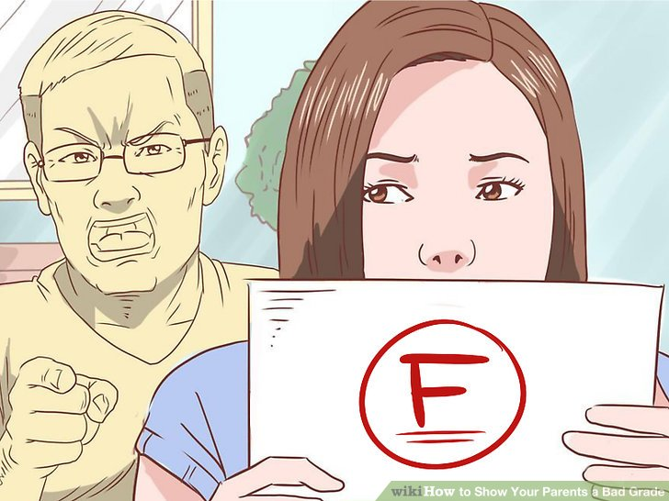
PART A: What predicts our grades?

Slide 5
Data Exploration
Looking for significant variables that could affect G3
Used Boxplots, Histogram, Scatterplots and tables
Selected 14 variables are the most likely to be significant:
G3 ~ sex + age + address + studytime + failures + activities + higher + internet + romantic + freetime + goout + health + absences + DWalc
DWalc = Weekday+ Weekend alcohol consumption

Slide 6
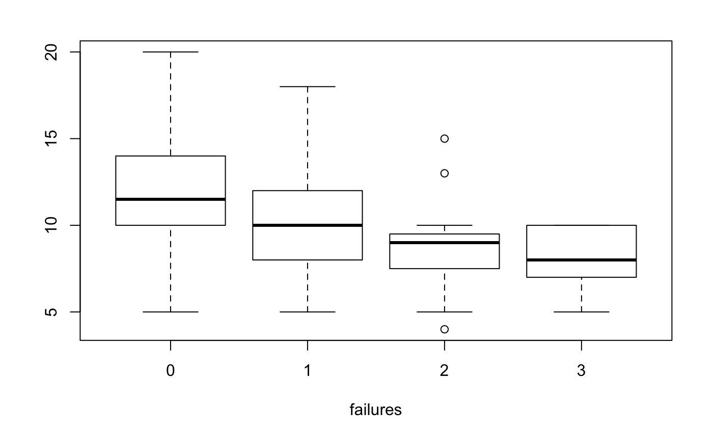
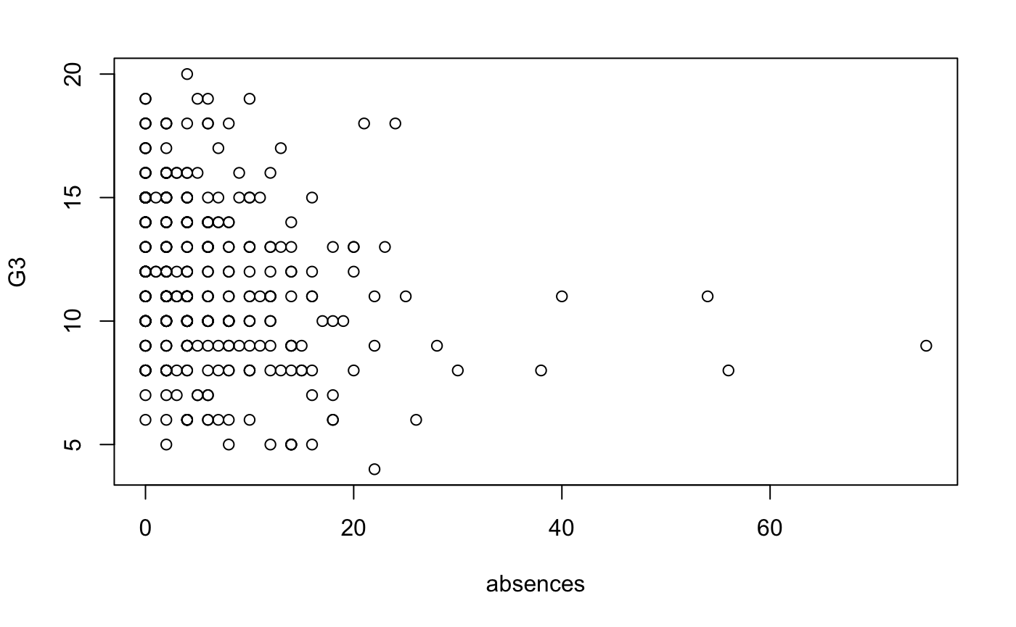
Examples of plots
G3~Failures
G3~Absences

Slide 7
Data Exploration
Looking for significant variables that could affect G3
Used Boxplots, Histogram, Scatterplots and tables
Selected 14 variables are the most likely to be significant:
G3 ~ sex + age + address + studytime + failures + activities + higher + internet + romantic + freetime + goout + health + absences + DWalc
DWalc = Weekday+ Weekend alcohol consumption

Slide 8
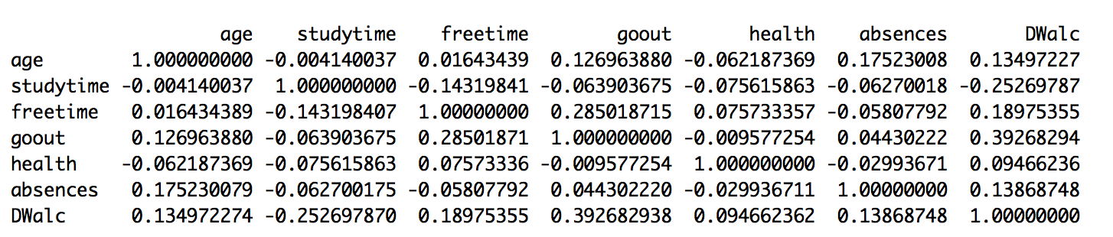
Testing for collinearity
Pairwise correlations
VIF
No pair-wise collinearity nor multiple collinearity problems

Slide 9
Diagnostic plots (problematic!)
Shapiro-Wilk test p-value: 2.108e-07
Normality and Equal variance assumptions are not met, and there is
a strange line in the residual vs fitted graph.
Need y transformations

Slide 10
What was the problem?
The diagnostic plot was not ideal
By looking at the data for those points we found out that those points are… 38 Zeros!
Zeros are removed.
New dataset contains cases in which students obtain positive final grades.

Slide 11
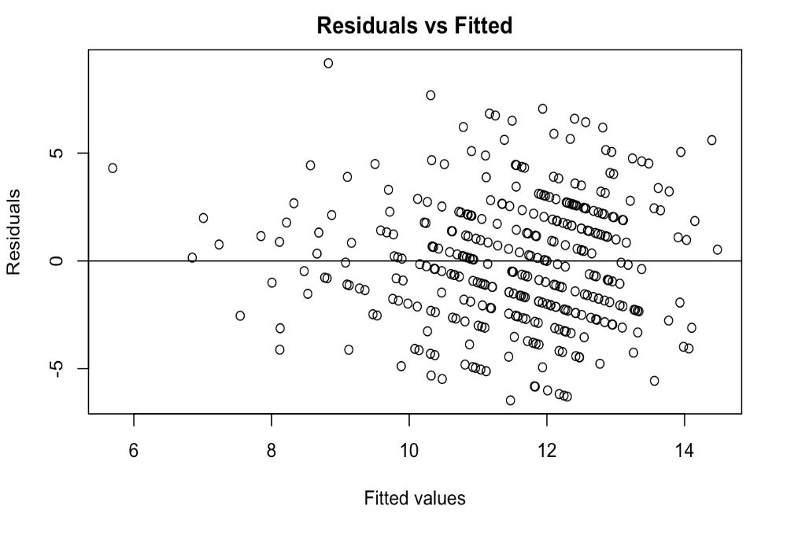
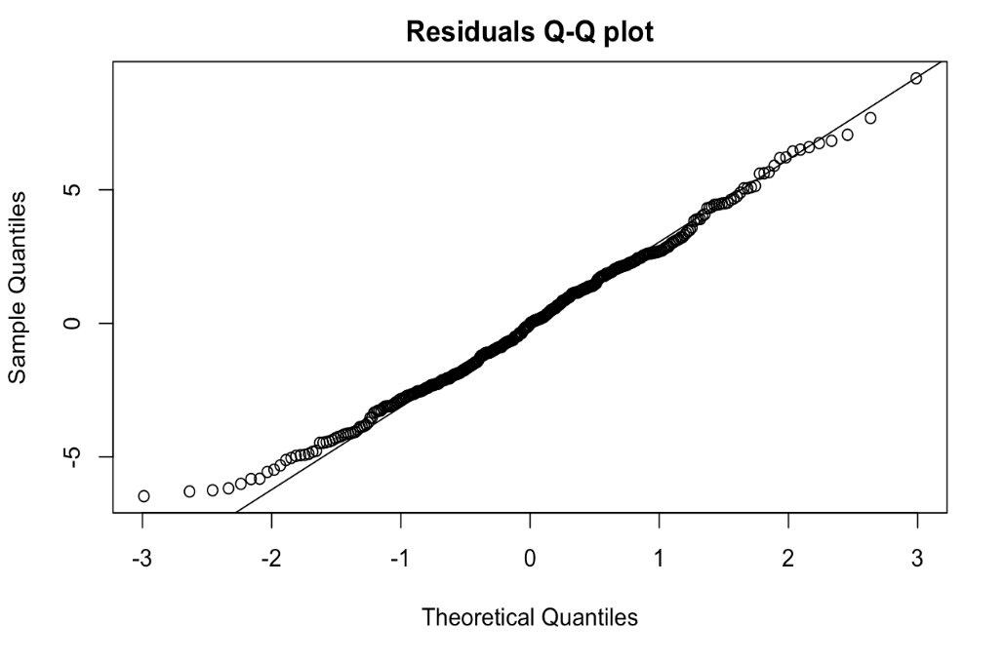
Diagnostic plots (fixed)
Linearity, Independence, Normality, Equal variance are met!
Shapiro-Wilk Test: p-value = 0.1262

Slide 12
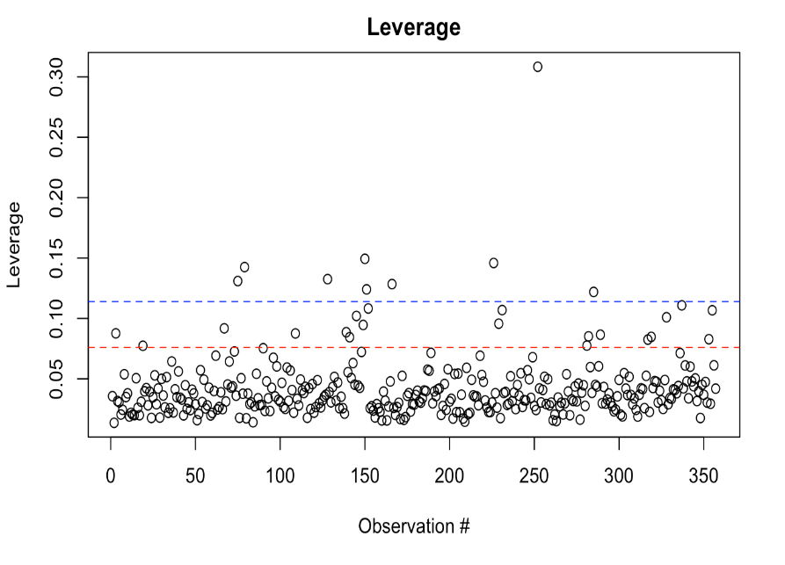
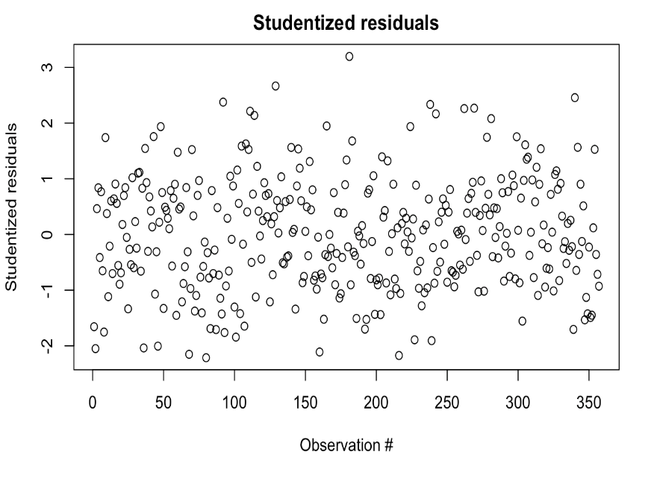
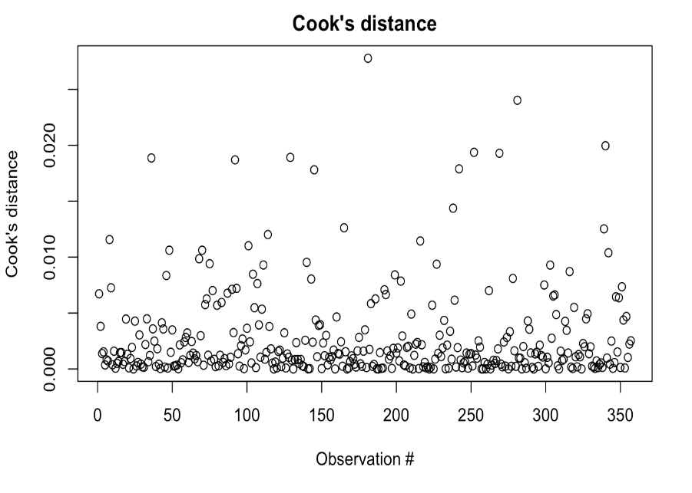
Testing for outliers
There are no influential outliers that should be removed

Slide 13
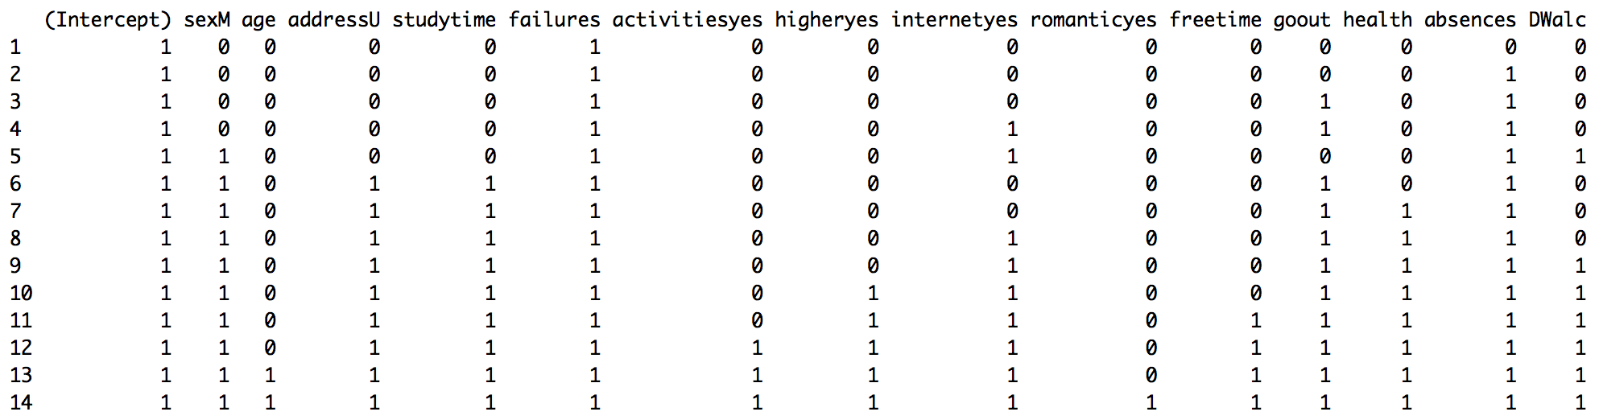
Model Selection
R², R² Adj, Lasso, Mallow C, AIC, BIC
Diagnostic plots, Shapiro-Wilk Test
VIFs

Slide 14
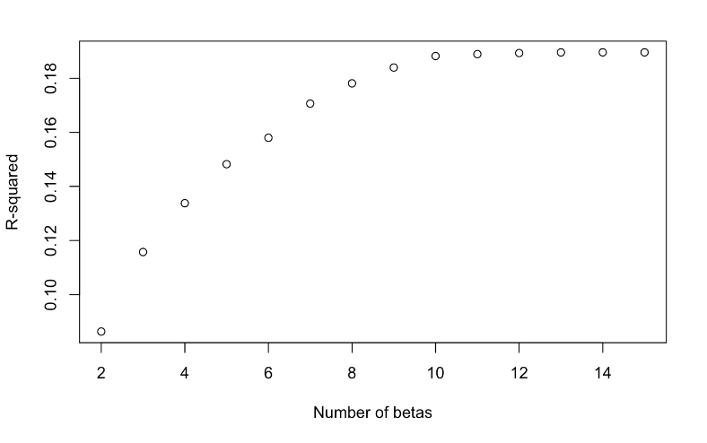
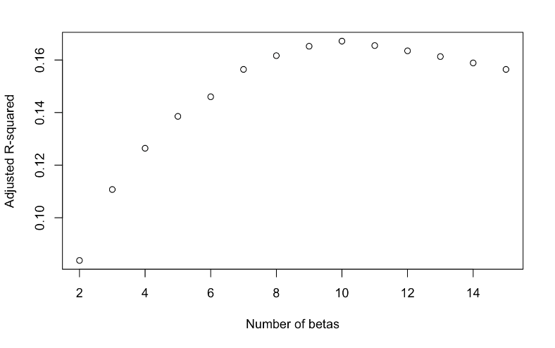
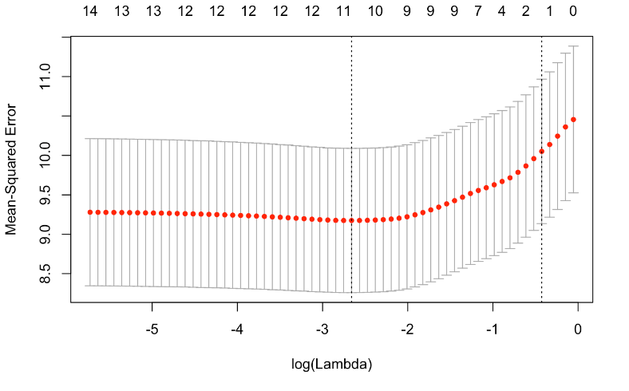
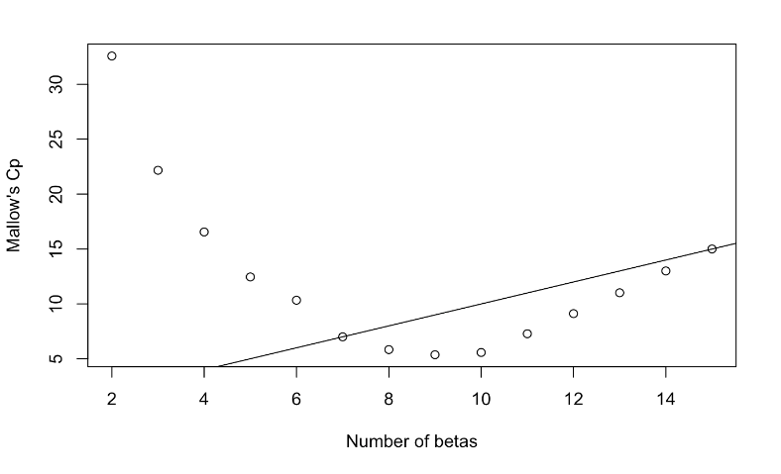
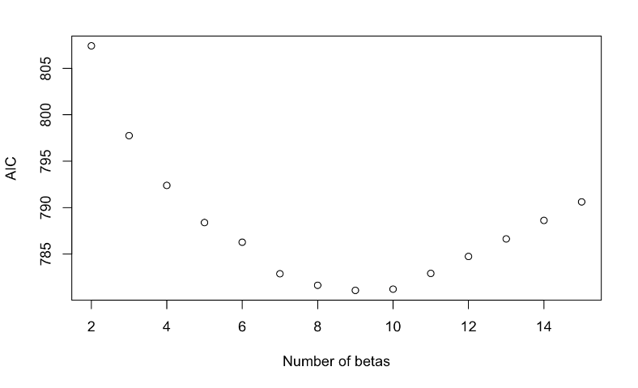
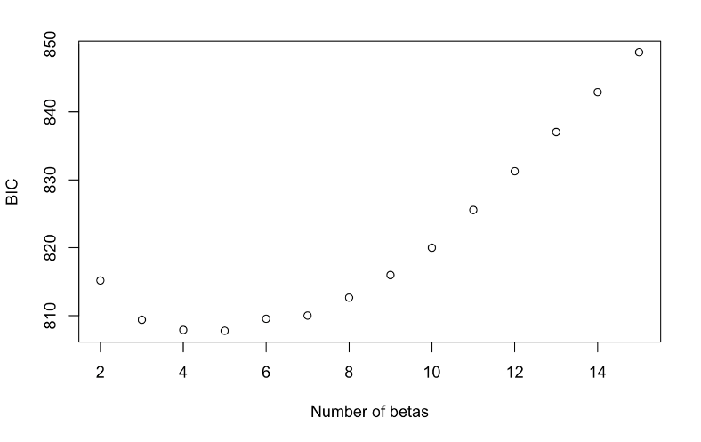
Best model selection

Slide 15
The four models

Slide 16
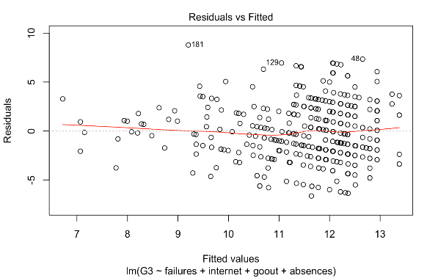
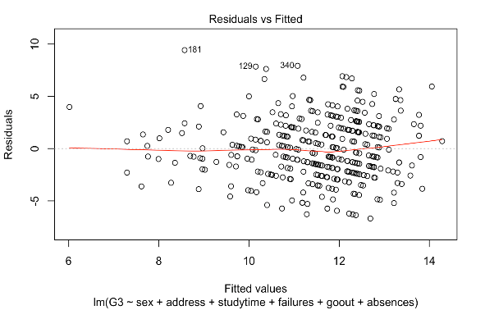
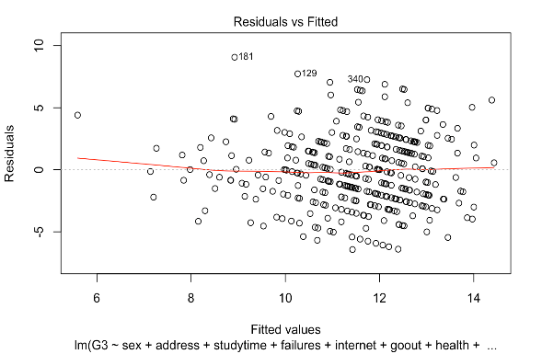
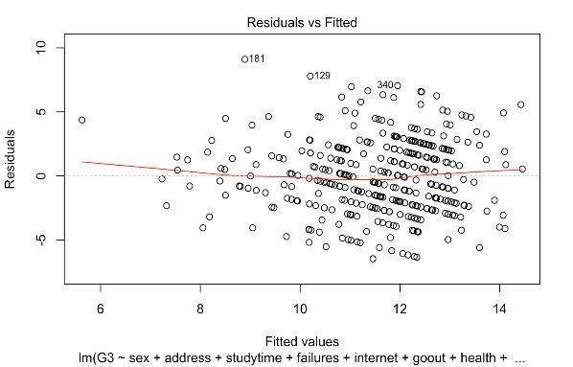
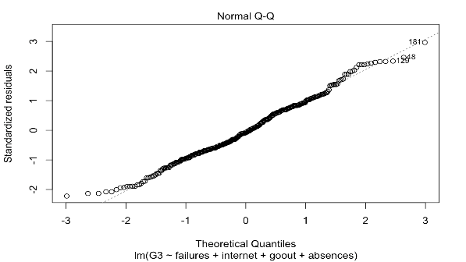
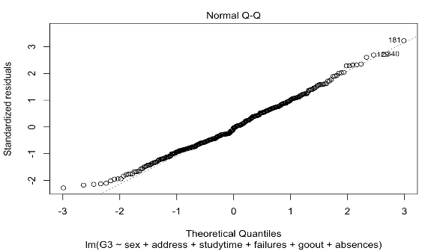


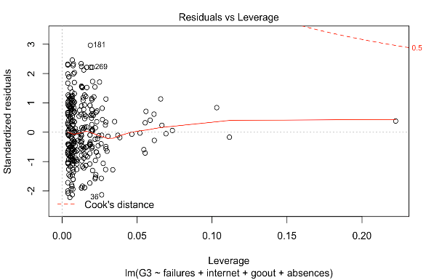
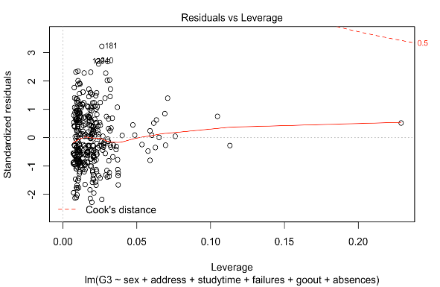
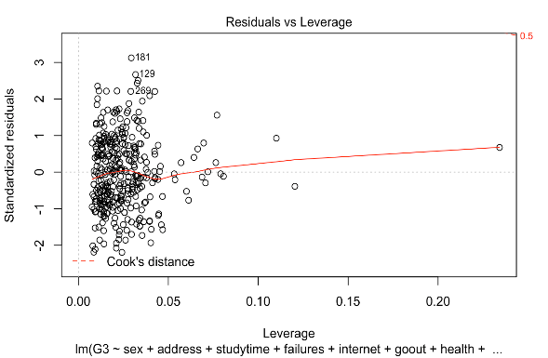
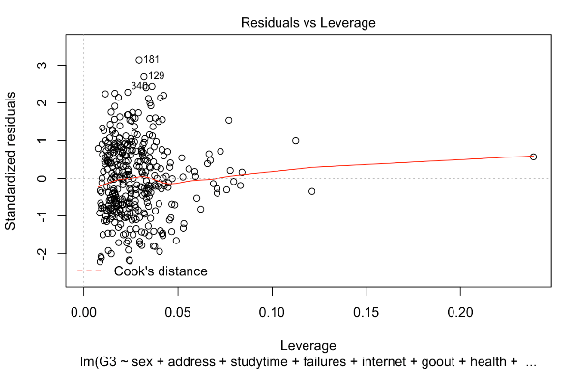
Diagnostic plots of the four models
Shapiro-Wilk test: p-value= 0.0224, p-value=0.06694 p-value= 0.08368 p-value= 0.1149
4 Beta 6 Beta 8 Beta 9 Beta

Slide 17
Which one is the best one?
Best model selection:
R², R² Adj, Lasso, Mallow C, AIC, BIC
Diagnostic plots, Shapiro-Wilk Test
VIFs
Model with 6 predictors: $G3=β_{0}+β_{1}sexM+β_{2}addressU+β_{3}studytime+β_{4 }failures+ β_{5}gouout++β_{6}absences+ ε$
Model with 6 predictors: 𝐺3=𝛽_0+𝛽_1 𝑠𝑒𝑥𝑀+𝛽_2 𝑎𝑑𝑑𝑟𝑒𝑠𝑠𝑈+𝛽_3 𝑠𝑡𝑢𝑑𝑦𝑡𝑖𝑚𝑒+𝛽_(4 ) 𝑓𝑎𝑖𝑙𝑢𝑟𝑒𝑠+ 𝛽_5 𝑔𝑜𝑢𝑜𝑢𝑡++𝛽_6 𝑎𝑏𝑠𝑒𝑛𝑐𝑒𝑠+ 𝜀

Slide 18
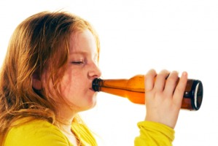



PART B: If we drink Alcohol often….
Notes:
As we said at the beginning, our second major question is whether alcohol consumption is a significant predictor of grade or not. To do so, we create two model. The first one, we compute a t-test with a simple linear regression, with just the alcohol consumption variable and the grade as the response. In the second one, we compute a partial f-test to see whether the alcohol is significant when we consider other predictors.

Slide 19
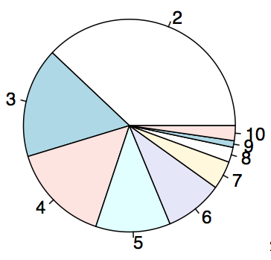
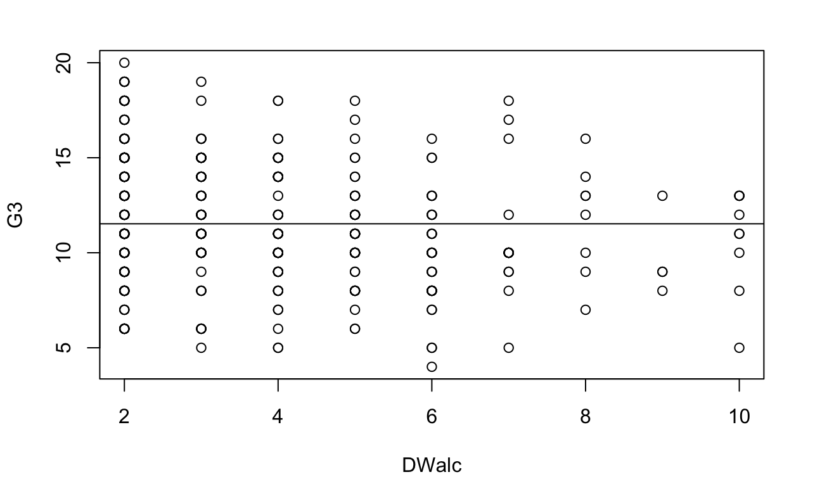
Alcohol consumption distribution
Low to no drinking
Notes:
Before doing the test, we want to look at the distribution of the alcohol consumption variable. As a reminder, we created the variable by adding together weekday and weekend alcohol consumption. Both weekday and weekend alcohol consumption is measured as 1-5. 1 is the lowest and 5 is the highest. Add together. The right graph is the weekday vs the grade ;s distribution. There is not an obvious correlation between alcohol consumption and final grade, but we see a small decreasing trend.

Slide 20
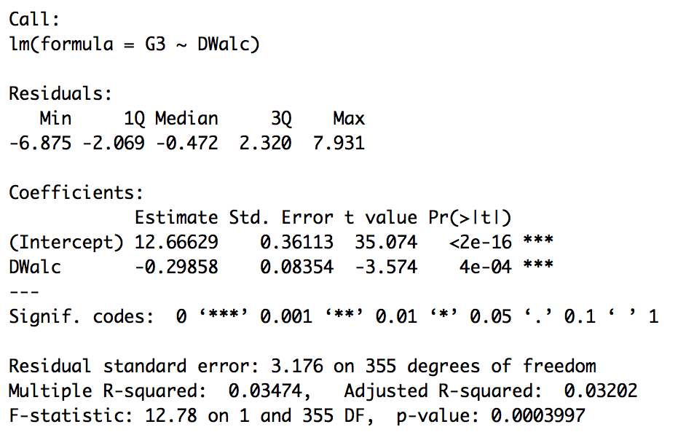
G3 ~ DWalc
It’s significant!
For every increase in unit of alcohol consumption, there is a 0.3 decrease of final grade score. But it is not a good model (R² is low)
Notes:
Here is our simple linear regression model: as we seen from the previous distribution graph, alcohol consumption and final grade are negatively correlated. From this analysis, we can say that for every increase in unit of alcohol consumption, there is a 0.3 decrease of final grades score. But it is not a good model (R² is low)
Alcohol in this simple linear regression model is still significant.

Slide 21
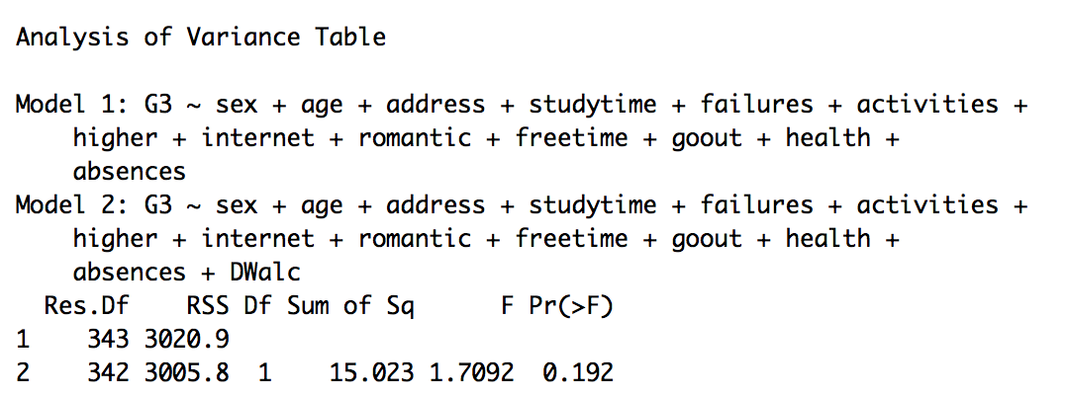
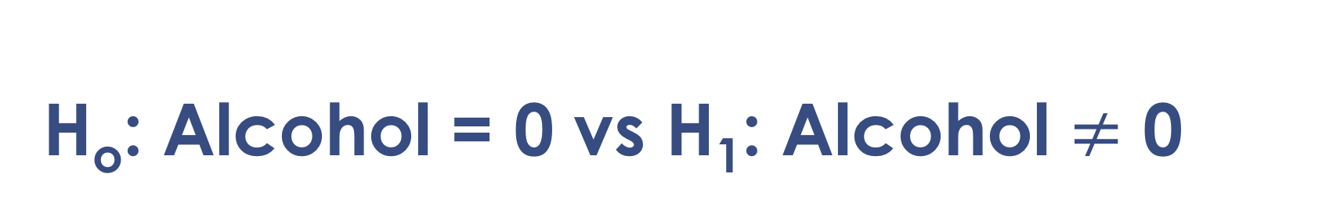
H_{o}: Alcohol = 0 vs H₁: Alcohol $≠$ 0
Alcohol is not significant when including the other variables
Notes:
Then, we compute the partial F test with the full model we used before the model selection in part A. The reduced model is the one that has all the variables in the full model but alcohol consumption. From this anova table, we see that alcohol is not significant anymore when the other variables are taken into consideration.

Slide 22
Add a Slide Title - 1
In conclusion
Best predictors of grades
Alcohol as a predictor
If considered by itself, it is significant
If considered in the full model, it is not significant
Sex, address (Urban vs Rural), study time, failures of past classes, go out, absences

Slide 23
Limitations and Further Research
Missing potentially significant factors: family’s income, quality of previous education, family issues, student’s psychological state, safety of school district, safety of neighborhood
Deleted final grade zeros are strange (some students have studied over 10 hours per week). Reasons may be low quality of study or drop out from the course

Slide 24


